Slide 1
Ridership Stats and Opportunities with New York MTA Data
WomenTechWomenYes International
BenAri Consulting

Slide 2

Introduction
WTWY International Awareness
Maximize Gala Participation
Data driven insights
Notes:
Find pic that has multiple women collaborating, saw one on pexel
Spaces between lines
Text is busy: long time to process. Lots of bullet points. Kill “success go forward strategy” and rethink “how will we do this”

Slide 3

Methodology
Maximize Awareness and Participation
Analyzing MTA Ridership
Highest Median Ridership
Time Series and Stability
Weather Correlations
Notes:
Spaces between lines
Reword “maximize awareness and participation”; that’s our goal, not really our method
Indent “why median” under highest median ridership
Makes clicks between lines

Slide 4
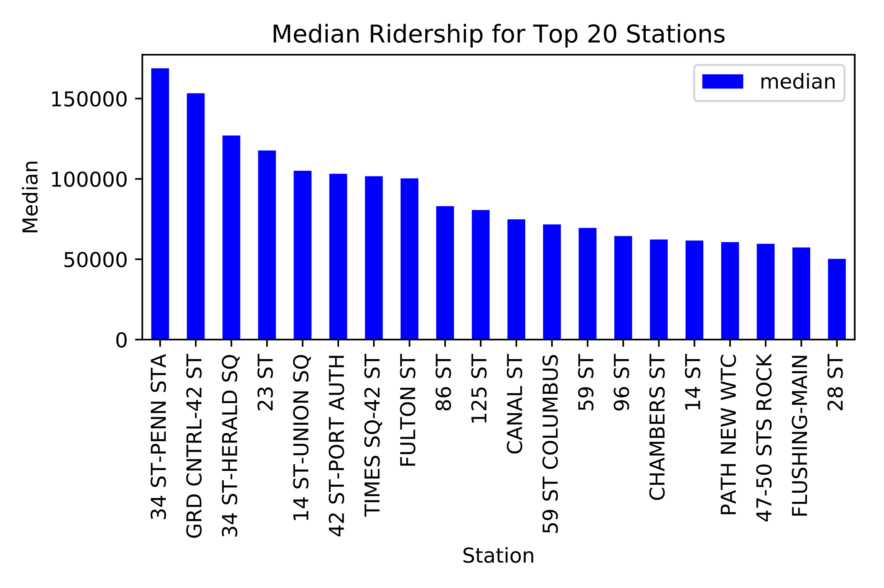
Methodology
MTA Data [Link]
Median Ridership Top 20 Stations
Median Ridership Over Time
IQR of Ridership Over Time
Notes:
Bigger text, Centered in left half, spaces between lines
MTA DATA
Click ->
Median ridership top 20 stations
Click ->
Median ridership over time
IQR ridership over time
Click ->
graphic

Slide 5
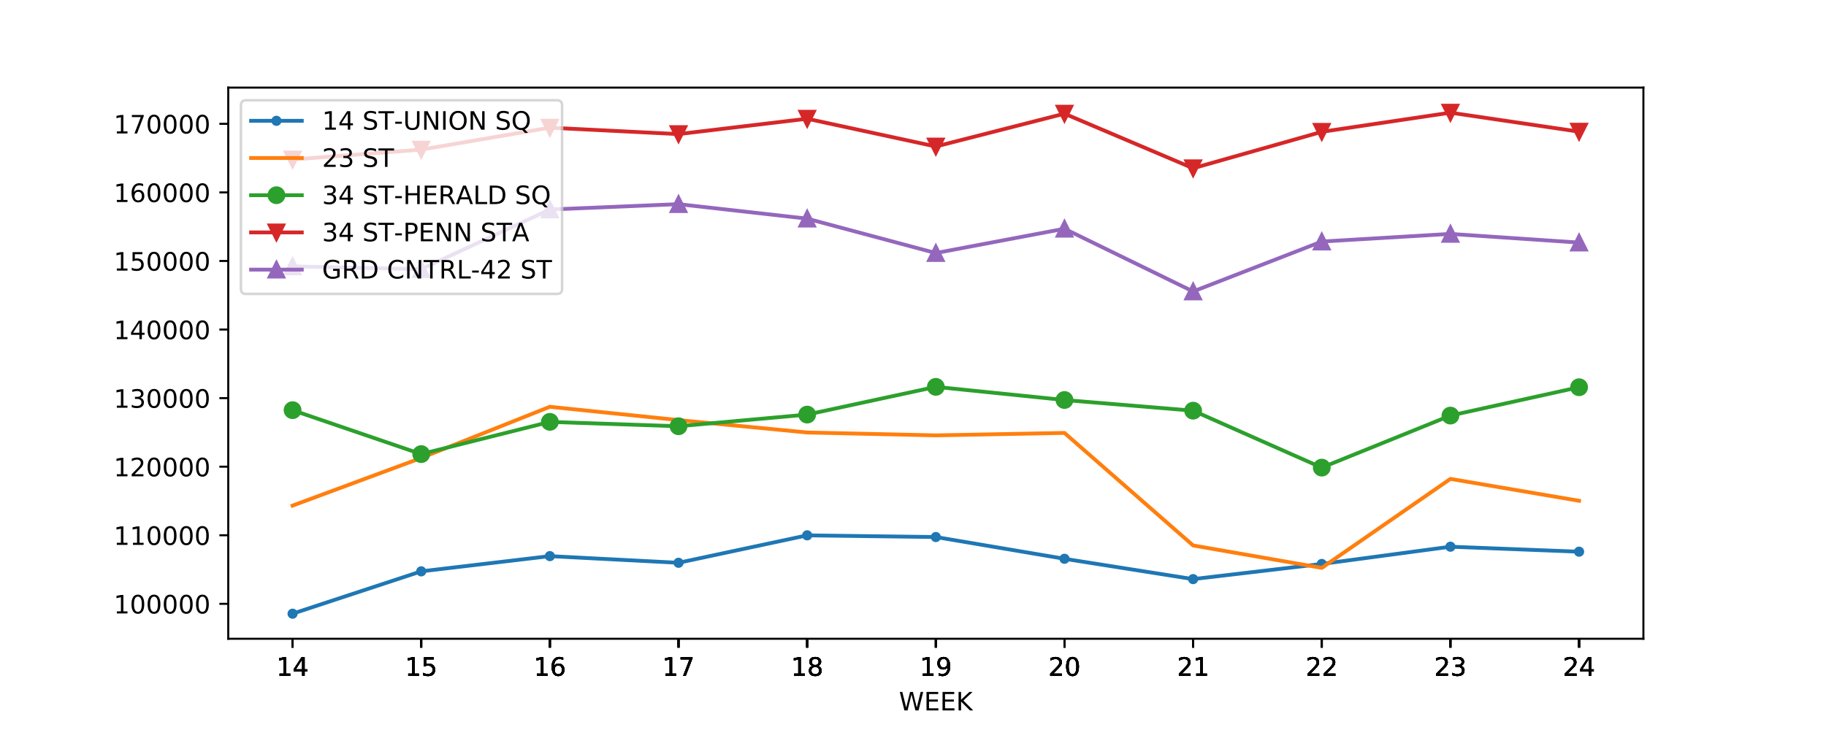
Results
Medians by Week
Median by Week of Top 5 Stations
Notes:
Bigger text, Centered in left half, no bullet
Click ->
graphic

Slide 6
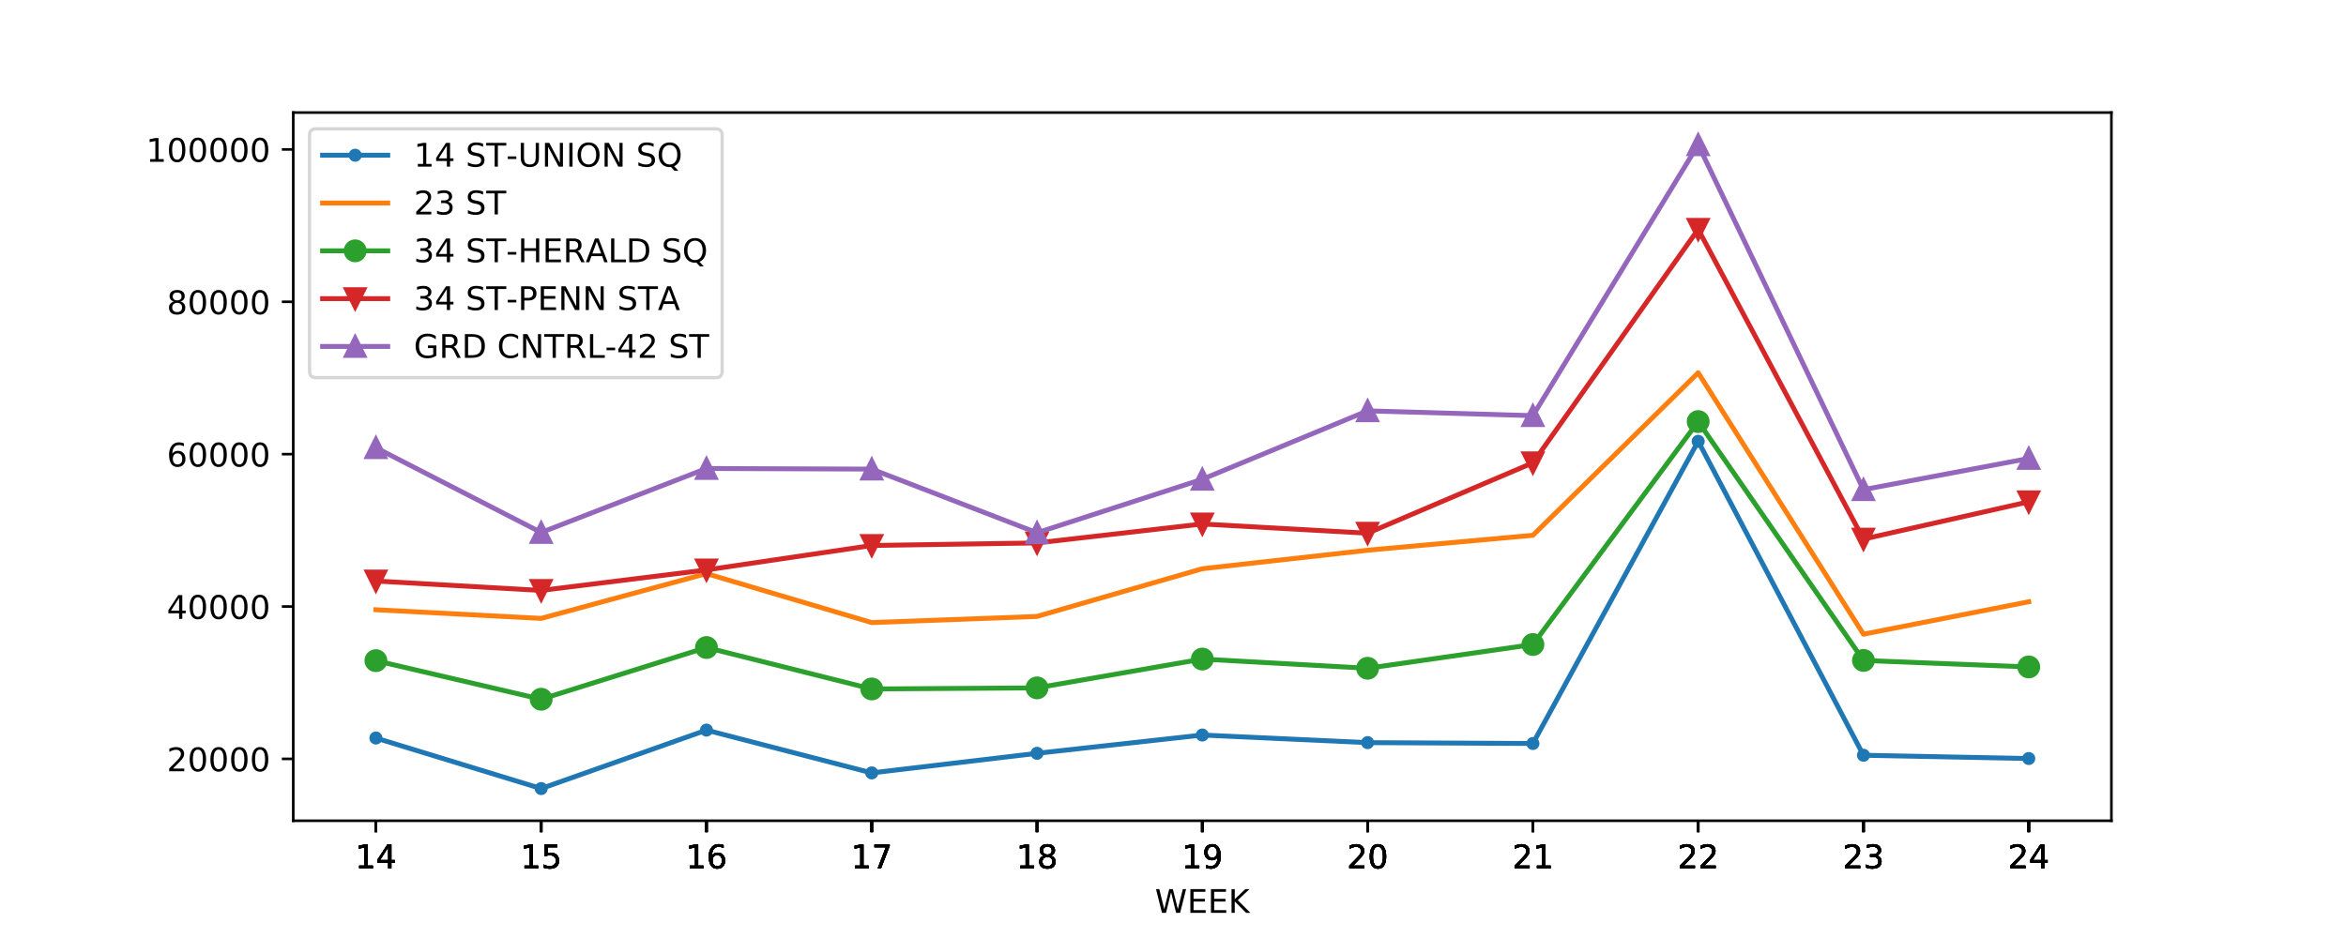
Results
IQR by Week
IQR by Week of Top 5 Stations
Notes:
Bigger text, Centered in left half, no bullet
Click ->
graphic

Slide 7
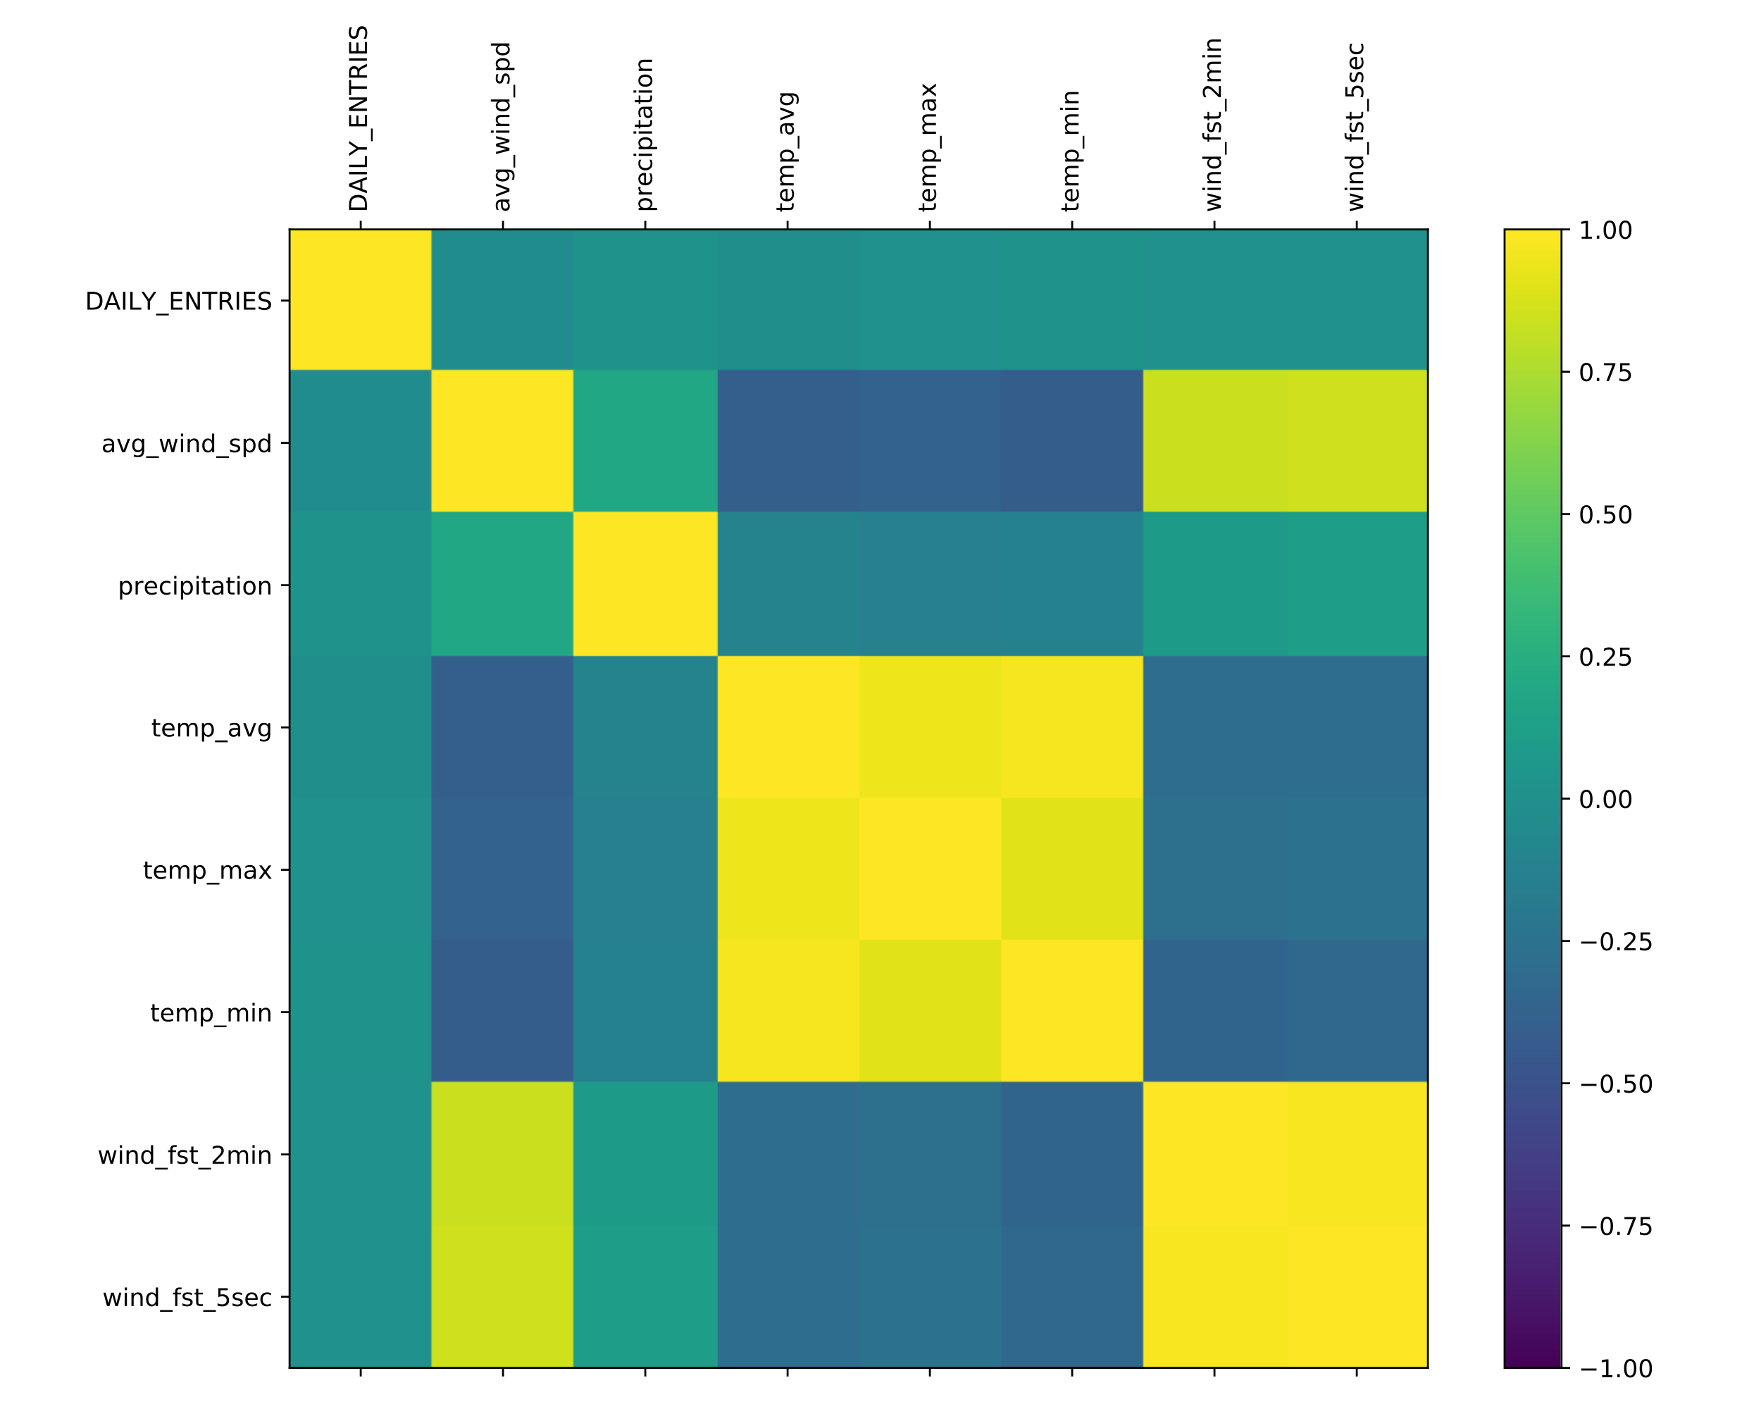



Results
Weather Indicators for Top 5 Stations
Correlations Near Zero
Notes:
“Weather indicators correlated with daily ridership”
Click ->
Correlations close to 0

Slide 8

Conclusions
Medians are solid indicators
IQRs do not give off any red flag
Confidence in allocation of WTWY Street Team
Notes:
Much larger text, centered
Clicks between lines
Reword ”confidence in allocation . . . “

Slide 9

Future Work
Weather Correlations by Stations
Multiple Years Runs for same time frame
Street Team Travel Distance Optimization
Notes:
Much larger text, centered
Clicks between lines
Reword ”confidence in allocation . . . “

Slide 10
THANK YOU

